Slide 1


Cultural Hierarchies and Music Education for Social Change: Neocolonialism and Coloniality in the SOMOS Música Program
Juan Gabriel Wayar De la Quintana | McGill University
Global Mediterranean. Postcolonial Music Histories (16th -20th centuries)
IMS Intercongressional Symposium
July 9-12, 2025. Valencia, Spain

Slide 2
Introduction

Slide 3
SOMOS MÚSICA pROGRAM
Founded in 2007.
Tuition-free alternative education initiative.
Based in Santa Fe, Argentina (Pop. 400 000).

Slide 4
SOMOS MÚSICA pROGRAM
Founded in 2007.
Tuition-free alternative education initiative.
Based in Santa Fe, Argentina (Pop. 400 000).
Its educational project aims for social impact (Diaz Geromet et al. 2024).
SOMOS relies on the “orchestra-school methodology” (Diaz Geromet et al. 2024).

Slide 5
Related scholarly work
El Sistema (Baker 2014; Verhagen, Panigada, and Morales 2016).
El Sistema inspired programs (Bull 2016, Baker 2022).

Slide 6
Related scholarly work
El Sistema (Baker 2014; Verhagen, Panigada, and Morales 2016).
El Sistema inspired programs (Bull 2016, Baker 2022).
Particularly:
Geoffrey Baker’s book: El Sistema: Orchestrating Venezuela´s Youth (2014)
Anna Bull’s article: “El Sistema as a Bourgeois Social Project: Class, Gender, and Victorian Values” (2016).

Slide 7
Thesis Statement
SOMOS exhibits strong aspects of coloniality.
It reproduces cultural hierarchies by positioning European aesthetics as superior.

Slide 8
Thesis Statement
SOMOS exhibits strong aspects of coloniality.
It reproduces cultural hierarchies by positioning European aesthetics as superior.
These hierarchies are in tension with participants’ preferences.
Cultural hybridization occurs as a way of resisting coloniality.

Slide 9
Methodology
Mixed-method approach: Document and own experiences analysis.
Personal experience analysis:
- Based on five years of professional experience in SOMOS Música.
- Focused on the relationship between participants and selected repertories.

Slide 10
Methodology
Mixed-method approach: Document and own experiences analysis.
Personal experience analysis:
- Based on five years of professional experience in SOMOS Música.
- Focused on the relationship between participants and selected repertories.
Theoretical Framework:
- Coloniality – Anibal Quijano (2007)
- Cultural Hybridity – Homi Bhabha (1988)
- Banking Education and Problem-posing Education – Freire (2000)

Slide 11
Methodology
Mixed-method approach: Document and own experiences analysis.
Personal experience analysis:
- Based on five years of professional experience in SOMOS Música.
- Focused on the relationship between participants and selected repertories.
Theoretical Framework:
- Coloniality – Anibal Quijano (2007)
- Cultural Hybridity – Homi Bhabha (1988)
- Banking Education and Problem-posing Education – Freire (2000)
Sources Analyzed:
- Syllabus for the ensemble course (Díaz Geromet et al. 2024).
- 2024 ODP Repertoire Report (Bustafán 2024)

Slide 12
Discussion
The Orchestra-School Methodology

Slide 13
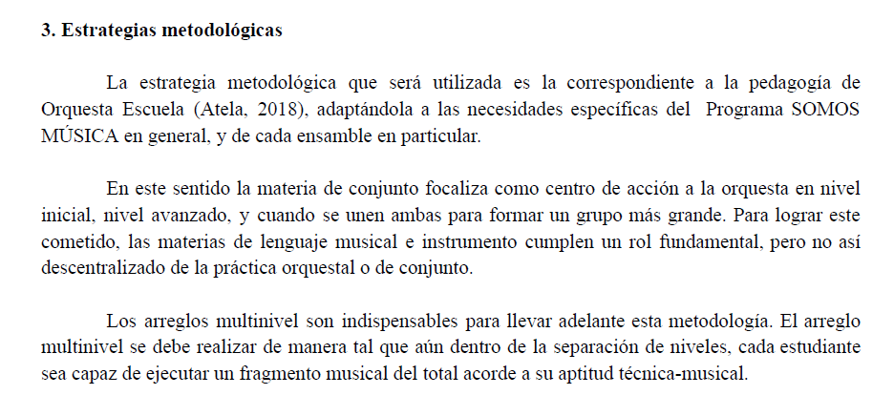
Victoria Díaz Geromet et al. “Cátedra: Conjunto” Unpublished document, Santa Fe: Secretaría de Cultura de la Municipalidad de Santa Fe, 2024, 4.

Slide 14
Victoria Díaz Geromet et al. “Cátedra: Conjunto” Unpublished document, Santa Fe: Secretaría de Cultura de la Municipalidad de Santa Fe, 2024, 4.

Slide 15
The “orchestra-school” methodology
There is no music history class.
Critical thinking about music is not encouraged.
There is an emphasis on performances and concerts.

Slide 16
The “orchestra-school” methodology
There is no music history class.
Critical thinking about music is not encouraged.
There is an emphasis on performances and concerts.
The methodology reflects Freire’s “banking education” model (2000).
Social goals are not discussed in class.

Slide 17
Discussion
The Repertoire

Slide 18
The repertoire varies yearly by conductor.
No record for beginners’ and intermediate ensembles.
ODP repertoire reflects the program’s values.

Slide 19
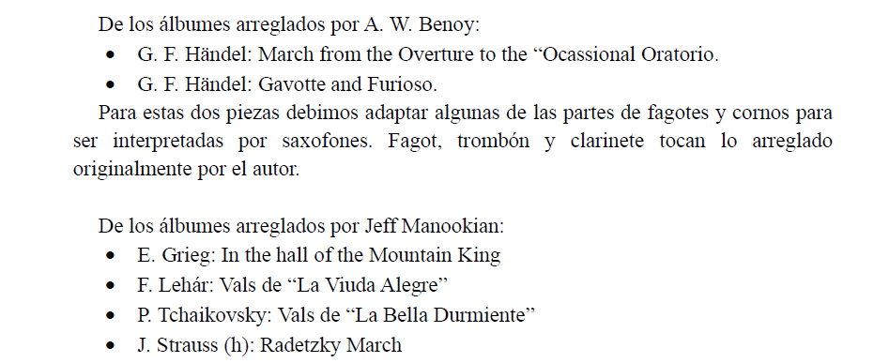
The repertoire varies yearly by conductor.
No record for beginners’ and intermediate ensembles.
ODP repertoire reflects the program’s values.
Main source: Manookian’s orchestral albums.
They focus on European classical music canon.
Matías Bustafán. “Informe de Repertorio General” Unpublished ducument, Santa Fe: Secretaría de Cultura de la Municipalidad de Santa Fe, 2024, 2.

Slide 20
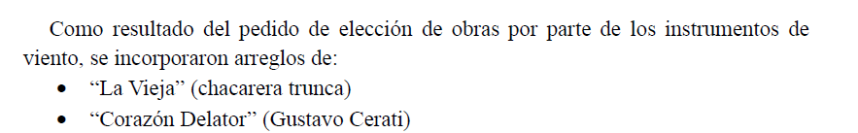
The repertoire
Participants suggested two popular pieces.
Contrast between written and oral traditions.
Classical music centers on the score.
Folkloric and rock music rely on oral transmission.
Matías Bustafán. “Informe de Repertorio General” Unpublished document, Santa Fe: Secretaría de Cultura de la Municipalidad de Santa Fe, 2024, 3.

Slide 21
Coloniality
SOMOS prioritizes written music traditions.
This reflects coloniality as theorized by Quijano (2007).
European classical music is reinforced as more relevant.

Slide 22
Coloniality
SOMOS prioritizes written music traditions.
This reflects coloniality as theorized by Quijano (2007).
European classical music is reinforced as more relevant.
Final concert is held at an opera theatre.
Venue choice raises questions about the social project.

Slide 23
Participants’ preferences
Participants listen to different music than the one studied in the program.
They constantly suggest reggaeton, trap, rap and cumbia.
Duki, Nicki Nicole, WOS and Maria Becerra were frequently mentioned.

Slide 24
Participants’ preferences
Participants listen to different music than the one studied in the program.
They constantly suggest reggaeton, trap, rap and cumbia.
Duki, Nicki Nicole, WOS and Maria Becerra were frequently mentioned.
Long- term students engage with classical music.
Popular music remain meaningful throughout.
Many participants join formal music institutions.

Slide 25
Participants’ preferences
Participants listen to different music than the one studied in the program.
They constantly suggest reggaeton, trap, rap and cumbia.
Duki, Nicki Nicole, WOS and Maria Becerra were frequently mentioned.
Long- term students engage with classical music.
Popular music remain meaningful throughout.
Many participants join formal music institutions.
Bhabha’s concept of “third space” (1988) applies.
Appropriation and resignification of classical music is a way of resisting coloniality.

Slide 26
Conclusions

Slide 27
Conclusions
SOMOS Música reflects aspects of coloniality through the use of the “orchestra-school” methodology and repertoire choices.
The “orchestra-school methodology” does not encourage critical thinking, mirroring the “banking education” model. (Freire 2000)
ODP repertoire’s preference for European classical music reproduces modern ideals inherited from colonial times.
Participants are not passive receivers. They appropriate and resignify the new cultural signifiers as a way of resistance (Bhabha 1988).

Slide 28
References
Atela, Valeria. 2018. “Introducción a la Metodología Orquesta Escuela.” Campus Virtual SOIJAR. https://www.sistemadeorquestas.org.ar/metodolog%C3%ADa-orquesta-escuela.
Baker, Geoffrey. 2014. El Sistema: Orchestrating Venezuela’s Youth. New York: Oxford University Press.
———. 2022. Replanteando la Acción Social por la Música: La Búsqueda de la Convivencia y la Ciudadanía en la Red de Escuelas de Música de Medellín. Cambridge, UK: Open Book Publishers. https://doi.org/10.11647/OBP.0263.
Bennett, Tony, Mike Savage, Elizabeth Bortolaia Silva, Alan Warde, Modesto Gayo-Cal, and David Wright. 2008 Culture, Class, Distinction. First edition. London: Routledge.
Bhabha, Homi. 1988. “Cultural Diversity and Cultural Differences.” From “The Commitment to Theory.” New Formations 5. Reprinted in Post-Colonial Studies Reader, edited by Bill Ashcroft, Gareth Griffiths, and Helen Tiffin, 206–209. London: Routledge, 1994.
Bull, Anna. 2016. “El Sistema as a Bourgeois Social Project: Class, Gender, and Victorian Values.” Action, Criticism, and Theory for Music Education 15 (1): 120– 153.
Bustafán, Matías. 2024. “Informe de Repertorio General” Unpublished document, Santa Fe: Secretaría de Cultura de la Municipalidad de Santa Fe.
Díaz Geromet, Victoria, Flavio Gilli, Ignacio Sánchez, Marco Esteban Suarez Araujo and Juan Gabriel Wayar De la Quintana. 2024. “Cátedra: Conjunto” Unpublished document, Santa Fe: Secretaría de Cultura de la Municipalidad de Santa Fe.
Freire, Paulo. 2000. Pedagogy of the Oppressed. Translated by Myra Bergman Ramos. 30th anniversary ed. New York: Continuum.
Manookian, Jeff. 2011. Album of Classical Themes for the Junior String Orchestra: Simplified Arrangements of Famous Works. Windsor Editions.
Pletti, Gastón. n.d. La Práctica Orquestal en la Metodología Orquesta Escuela. Reflexiones
Sobre la Práctica Colectiva y el Rol del Profesor de Práctica Orquestal. Campus Virtual SOIJAR. https://www.sistemadeorquestas.org.ar/campusvirtual.
Quijano, Aníbal. 2007. “Coloniality and Modernity/Rationality.” Cultural Studies 21 (2–3): 168–178. https://doi.org/10.1080/09502380601164353.
Verhagen, Franka, Leonardo Panigada, and Ronnie Morales. 2016. "El Sistema Nacional de Orquestas y Coros Juveniles e Infantiles de Venezuela: Un Modelo Pedagógico de Inclusión Social a Través de la Excelencia Musical." Revista Internacional de Educación Musical 4 (4): 35–46. https://doi.org/10.12967/RIEM-2016-4-p035-046.

